Slide 1
CS 540 Computer Networks II
Sandy Wang
sandy.w@svuca.edu

Slide 2
6. Routing Protocols – RIP & OSPF
Notes:
In this chapter, we look at the underlying technology and protocol architecture
of LANs. Chapters 12 and 13 are devoted to a discussion of specific
LAN systems.

Slide 3
Topics
Overview
LAN Switching
IPv4
IPv6
Tunnels
Routing Protocols -- RIP, RIPng
Routing Protocols -- OSPF
Midterm Exam
IS-IS
BGP
MPLS
Transport Layer -- TCP/UDP
Congestion Control & Quality of Service (QoS)
Access Control List (ACL)
Final Exam

Slide 4
Reference Books
Routing TCP/IP Volume I, 2nd Edition by Jeff Doyle and Jennifer Carroll
ISBN: 1-57870-089-2
Routing TCP/IP Volume II by Jeff Doyle and Jennifer DeHaven ISBN: 1-57870-089-2
Cisco CCNA Routing and Switching ICND2 200-101 Official Cert Guide, Academic Edition by Wendel Odom -- July 10, 2013. ISBN-13: 978-1587144882
The TCP/IP Guide: A Comprehensive, Illustrated Internet Protocols Reference by Charles M. Kozierok – October 1, 2005. ISBN-13: 978-1593270476
CCNA Routing and Switching 200-120 Network Simulator. By Wendell Odom, Sean Wilkins. Published by Pearson IT Certification.
http://class.svuca.edu/~sandy/class/CS540/

Slide 5
Topics:
RIP
OSPF

Slide 6
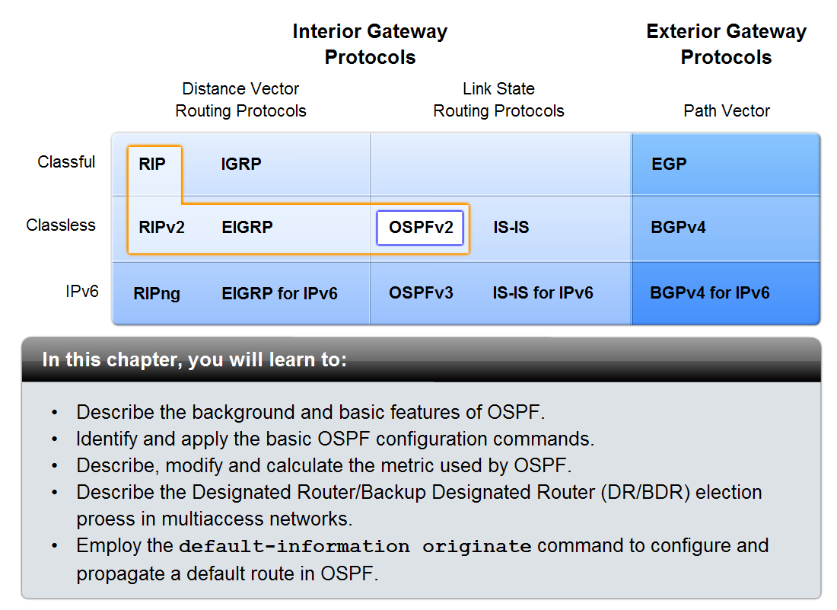
Introduction

Slide 7
B
A
C
E
D
 | A | B | C | D | E
A | 0 | 1 | 1 | 1 | ∞
B | 1 | 0 | ∞ | ∞ | 1
C | 1 | ∞ | 0 | 1 | ∞
D | 1 | ∞ | 1 | 0 | 1
E | ∞ | 1 | ∞ | 1 | 0
Notes:
A

Slide 8
B
A: Routing Table
B: Routing Table
 | Cost | Nexthop
A | 0 | --
B | 1 | B
C | 1 | C
D | 1 | D
E | ∞ | ?
 | Cost | Nexthop
A | 1 | A
B | 0 | --
C | ∞ | ?
D | ∞ | ?
E | 1 | E
A
C
E
D
C: Routing Table
D: Routing Table
E: Routing Table
 | Cost | Nexthop
A | 1 | A
B | ∞ | ?
C | 0 | --
D | 1 | D
E | ∞ | ?
 | Cost | Nexthop
A | 1 | A
B | ∞ | ?
C | 1 | C
D | 0 | --
E | 1 | E
 | Cost | Nexthop
A | ∞ | ?
B | 1 | B
C | ∞ | ?
D | 1 | D
E | 0 | --
Notes:
A

Slide 9
B
B → A
A: Routing Table
 | Cost | Nexthop
A | 0 | --
B | 1 | B
C | 1 | C
D | 1 | D
E | ∞ | ?
 | Cost | Nexthop
A | 1 | A
B | 0 | --
C | ∞ | ?
D | ∞ | ?
E | 1 | E
A
C
E
D
C → A
D → A
 | Cost | Nexthop
A | 1 | A
B | ∞ | ?
C | 0 | --
D | 1 | D
E | ∞ | ?
 | Cost | Nexthop
A | 1 | A
B | ∞ | ?
C | 1 | C
D | 0 | --
E | 1 | E
Notes:
A

Slide 10
B
A
C
E
D
A: Routing Table
B → A
A: Routing Table
 | Cost | Nexthop
A | 0 | --
B | 1 | B
C | 1 | C
D | 1 | D
E | ∞ | ?
 | Cost | Nexthop
A | 1 | A
B | 0 | --
C | ∞ | ?
D | ∞ | ?
E | 1 | E
 | Cost | Nexthop
A | 0 | --
B | 1 | B
C | 1 | C
D | 1 | D
E | 2 | B
Notes:
A

Slide 11
B
A
C
E
D
A: Routing Table
C → A
A: Routing Table
 | Cost | Nexthop
A | 0 | --
B | 1 | B
C | 1 | C
D | 1 | D
E | 2 | B
 | Cost | Nexthop
A | 1 | A
B | ∞ | ?
C | 0 | --
D | 1 | D
E | ∞ | ?
 | Cost | Nexthop
A | 0 | --
B | 1 | B
C | 1 | C
D | 1 | D
E | 2 | B
Notes:
A

Slide 12
B
A
C
E
D
A: Routing Table
D → A
A: Routing Table
 | Cost | Nexthop
A | 0 | --
B | 1 | B
C | 1 | C
D | 1 | D
E | 2 | B
 | Cost | Nexthop
A | 1 | A
B | ∞ | ?
C | 1 | C
D | 0 | --
E | 1 | E
 | Cost | Nexthop
A | 0 | --
B | 1 | B
C | 1 | C
D | 1 | D
E | 2 | B, D
Notes:
A

Slide 13
B
B: Routing Table
B: Routing Table
 | Cost | Nexthop
A | 1 | A
B | 0 | --
C | ∞ | ?
D | ∞ | ?
E | 1 | E
 | Cost | Nexthop
A | 1 | A
B | 0 | --
C | 2 | A
D | 2 | A, E
E | 1 | E
A
C
E
D
A → B
E → B
 | Cost | Nexthop
A | 0 | --
B | 1 | B
C | 1 | C
D | 1 | D
E | ∞ | ?
 | Cost | Nexthop
A | ∞ | ?
B | 1 | B
C | ∞ | ?
D | 1 | D
E | 0 | --
Notes:
A

Slide 14
B
C: Routing Table
C: Routing Table
 | Cost | Nexthop
A | 1 | A
B | ∞ | ?
C | 0 | --
D | 1 | D
E | ∞ | ?
 | Cost | Nexthop
A | 1 | A
B | 2 | A
C | 0 | --
D | 1 | D
E | 2 | D
A
C
E
D
A → C
D → C
 | Cost | Nexthop
A | 0 | --
B | 1 | B
C | 1 | C
D | 1 | D
E | ∞ | ?
 | Cost | Nexthop
A | 1 | A
B | ∞ | ?
C | 1 | C
D | 0 | --
E | 1 | E
Notes:
A

Slide 15
B
D: Routing Table
D: Routing Table
 | Cost | Nexthop
A | 1 | A
B | ∞ | ?
C | 1 | C
D | 0 | --
E | 1 | E
 | Cost | Nexthop
A | 1 | A
B | 2 | A, E
C | 1 | C
D | 0 | --
E | 1 | E
A
C
E
D
A → D
C → D
E → D
 | Cost | Nexthop
A | 0 | --
B | 1 | B
C | 1 | C
D | 1 | D
E | ∞ | ?
 | Cost | Nexthop
A | 1 | A
B | ∞ | ?
C | 0 | --
D | 1 | D
E | ∞ | ?
 | Cost | Nexthop
A | ∞ | ?
B | 1 | B
C | ∞ | ?
D | 1 | D
E | 0 | --
Notes:
A

Slide 16
B
E: Routing Table
E: Routing Table
 | Cost | Nexthop
A | ∞ | ?
B | 1 | B
C | ∞ | ?
D | 1 | D
E | 0 | --
 | Cost | Nexthop
A | 2 | B, D
B | 1 | B
C | 2 | D
D | 1 | D
E | 0 | --
A
C
E
D
B → E
D → E
 | Cost | Nexthop
A | 1 | A
B | 0 | --
C | ∞ | ?
D | ∞ | ?
E | 1 | E
 | Cost | Nexthop
A | 1 | A
B | ∞ | ?
C | 1 | C
D | ∞ | ?
E | 1 | E
Notes:
A

Slide 17
B
A: Routing Table
B: Routing Table
 | Cost | Nexthop
A | 0 | --
B | 1 | B
C | 1 | C
D | 1 | D
E | 2 | B, D
 | Cost | Nexthop
A | 1 | A
B | 0 | --
C | 2 | A
D | 2 | A, E
E | 1 | E
A
C
E
D
C: Routing Table
D: Routing Table
E: Routing Table
 | Cost | Nexthop
A | 1 | A
B | 2 | A
C | 0 | --
D | 1 | D
E | 2 | D
 | Cost | Nexthop
A | 1 | A
B | 2 | A, E
C | 1 | C
D | 0 | --
E | 1 | E
 | Cost | Nexthop
A | 2 | B, D
B | 1 | B
C | 2 | D
D | 1 | D
E | 0 | --
Notes:
A

Slide 18
B
1st Update
A
C
E
F
D
F: Routing Table
E → F
F: Routing Table
 | Cost | Nexthop
A | ∞ | ?
B | ∞ | ?
C | ∞ | ?
D | ∞ | ?
E | 1 | E
F | 0 | --
 | Cost | Nexthop
A | ∞ | ?
B | 1 | B
C | ∞ | ?
D | 1 | D
E | 0 | --
F | 1 | F
 | Cost | Nexthop
A | ∞ | ?
B | 2 | E
C | ∞ | ?
D | 2 | E
E | 1 | E
F | 0 | --
Notes:
A

Slide 19
11.0.0.2
B
2nd Update
11.0.0.1
A
C
E
F
D
F: Routing Table
E → F
F: Routing Table
 | Cost | Nexthop
A | ∞ | ?
B | 2 | E
C | ∞ | ?
D | 2 | E
E | 1 | E
F | 0 | --
 | Cost | Nexthop
A | 2 | B, D
B | 1 | B
C | 2 | D
D | 1 | D
E | 0 | --
F | 1 | F
 | Cost | Nexthop
A | 3 | E
B | 2 | E
C | 3 | E
D | 2 | E
E | 1 | E
F | 0 | --
Notes:
A

Slide 20
B
.2
11.0.0.0/16
12.0.0.0/16
13.0.0.0/16
A
C
E
17.0.0.0/16
F
.1
.5
.6
.3
15.0.0.0/16
14.0.0.0/16
16.0.0.0/16
D
F: Routing Table
.4
Dst | Cost | Nexthop
11.0.0.0/16 | 3 | 17.0.0.5
12.0.0.0/16 | 2 | 17.0.0.5
13.0.0.0/16 | 3 | 17.0.0.5
14.0.0.0/16 | 4 | 17.0.0.5
15.0.0.0/16 | 3 | 17.0.0.5
16.0.0.0/16 | 2 | 17.0.0.5
17.0.0.0/16 | 1 | connected
Notes:
A

Slide 21
Characteristics of Distance Vector Routing
Periodic Updates: Updates to the routing tables are sent at the end of a certain time period. A typical value is 90 seconds.
Triggered Updates: If a metric changes on a link, a router immediately sends out an update without waiting for the end of the update period.
Full Routing Table Update: Most distance vector routing protocol send their neighbors the entire routing table (not only entries which change).
Route invalidation timers: Routing table entries are invalid if they are not refreshed. A typical value is to invalidate an entry if no update is received after 3-6 update periods.

Slide 22
The Count-to-Infinity Problem
A
1
B
1
C

Slide 23
Count-to-Infinity
The reason for the count-to-infinity problem is that each node only has a “next-hop-view”
For example, in the first step, A did not realize that its route (with cost 2) to C went through node B
How can the Count-to-Infinity problem be solved?

Slide 24
Count-to-Infinity
The reason for the count-to-infinity problem is that each node only has a “next-hop-view”
For example, in the first step, A did not realize that its route (with cost 2) to C went through node B
How can the Count-to-Infinity problem be solved?
Solution: Never advertise the cost to a neighbor if this neighbor is the next hop on the current path (Split Horizon)
Example: A would not send the first routing update to B, since B is the next hop on A’s current route to C
Split Horizon does not solve count-to-infinity in all cases!

Slide 25
Split Horizon and Poison Reverse
One drawback of Split Horizon
Normally, the DV protocol uses a timer and if there is no news about a route, the node deletes the route from its table
In the previous e.g., node B cannot guess that this is due to split horizon or because A has not received any news about C recently
Poison Reverse
Node A can still advertise the value for C, but is the source of information is B, it can replace the distance with infinity as a warning

Slide 26
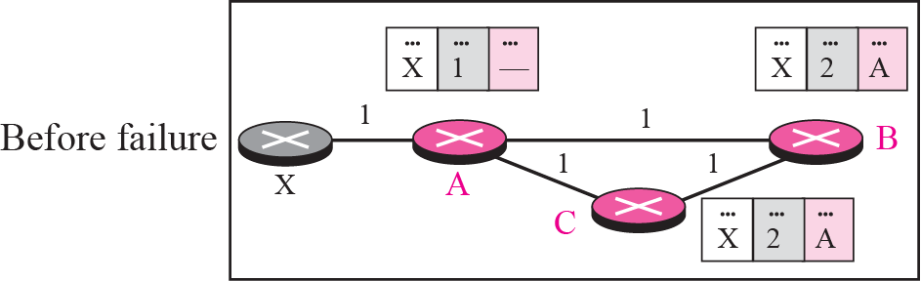
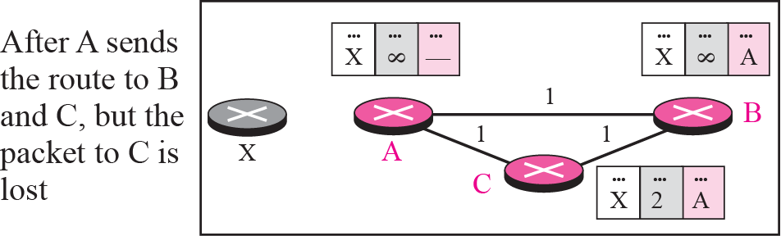
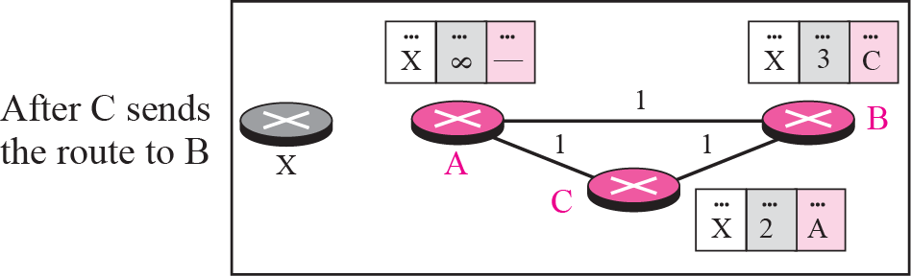
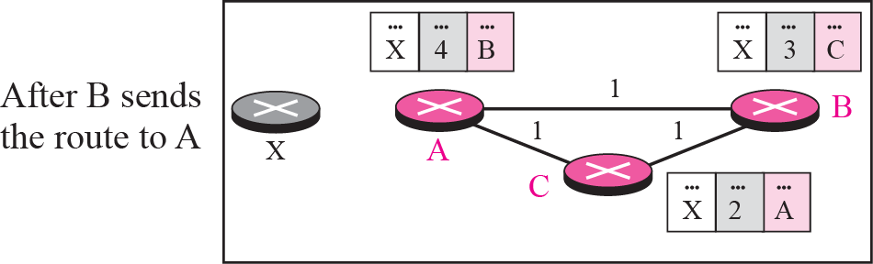
Three-node instability
If the instability is btw three nodes, stability cannot be guaranteed
Update loop until infinity

Slide 27
RIP - Routing Information Protocol
A simple intra-domain protocol
Straightforward implementation of Distance Vector Routing
Each router advertises its distance vector every 30 seconds (or whenever its routing table changes) to all of its neighbors
RIP always uses 1 as link metric
Maximum hop count is 15, with “16” equal to “∞”
Routes are timeout (set to 16) after 3 minutes if they are not updated

Slide 28
RIP - History
Late 1960s : Distance Vector protocols were used in the ARPANET
Mid-1970s: XNS (Xerox Network system) routing protocol is the precursor of RIP in IP (and Novell’s IPX RIP and Apple’s routing protocol)
1982 Release of routed for BSD Unix
1988 RIPv1 (RFC 1058) - classful routing
1993 RIPv2 (RFC 1388) - adds subnet masks with each route entry - allows classless routing
1998 Current version of RIPv2 (RFC 2453)

Slide 29
RIP Packet Format
MAC Hdr
IP Hdr
UDP Hdr
RIP Hdr
RIP type-specific Data
MAC Header
Src – MAC of sending interface
Dst – 0100:5E00:0009
Type – 0x0800
IP Header
Src – IP addr of sending interface
Dst – 224.0.0.9
Protocol – UDP 17
UDP Header
Port 520
MAC Header
Dst – 3333:0000:0009
Type – 0x86DD
IPv6 Header
Src – IPv6 addr of sending interface
Dst – FF02::9
Protocol – UDP 17
UDP Header
Port 521
Notes:
01:00:5E:00:00:00 - 01:00:5E:7F:FF:FF 0x0800 IPv4 Multicast (RFC 1112), insert the low 23 Bits of the multicast IPv4 Address into the Ethernet Address (RFC 7042 2.1.1.)
33:33:xx:xx:xx:xx 0x86DD IPv6 Multicast (RFC 2464), insert the low 32 Bits of the multicast IPv6 Address into the Ethernet Address (RFC 7042 2.3.1.)
224.0.0.5 The Open Shortest Path First (OSPF) All OSPF Routers address is used to send Hello packets to all OSPF routers on a network segment.
224.0.0.6 The OSPF All Designated Routers ""(DR)"" address is used to send OSPF routin`g information to designated routers on a network segment.

Slide 30
RIP Messages
This is the operation of RIP in routed. Dedicated port for RIP is UDP port 520.
Two types of messages:
Request messages
used to ask neighboring nodes for an update
Response messages
contains an update

Slide 31
RIPv1 Packet Format
1: RIPv1
1: request 2: response
2: for IP
0…0: request full rou-ting table
Address of destination
Cost (measured in hops)
One RIP message can have up to 25 route entries

Slide 32
RIPv2
RIPv2 is an extends RIPv1:
Subnet masks are carried in the route information
Authentication of routing messages
Route information carries next-hop address
Exploites IP multicasting
Extensions of RIPv2 are carried in unused fields of RIPv1 messages

Slide 33
RIPv2 Packet Format
2: RIPv2
Used to carry information from other routing protocols (e.g., autonomous system number)
Dst | Cost | Nexthop
11.0.0.0/16 | 3 | 17.0.0.5
12.0.0.0/16 | 2 | 17.0.0.5
13.0.0.0/16 | 3 | 17.0.0.5
14.0.0.0/16 | 3 | 17.0.0.5
15.0.0.0/16 | 3 | 17.0.0.5
16.0.0.0/16 | 2 | 17.0.0.5
17.0.0.0/16 | 1 | connected
Subnet mask for IP address
Identifies a better next-hop address on the same subnet than the advertising router, if one exists (otherwise 0….0)

Slide 34
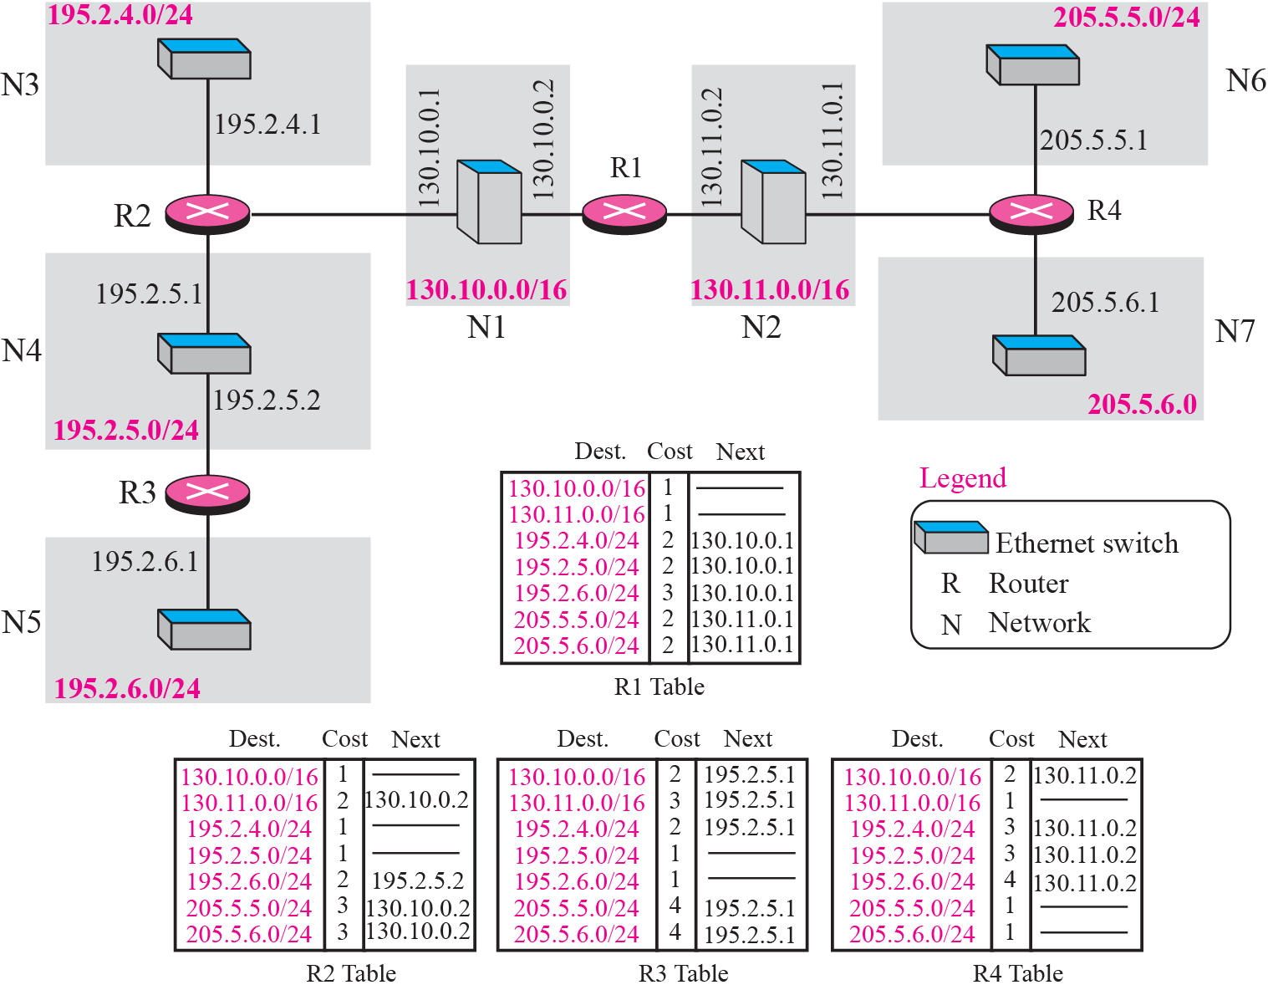

Slide 35
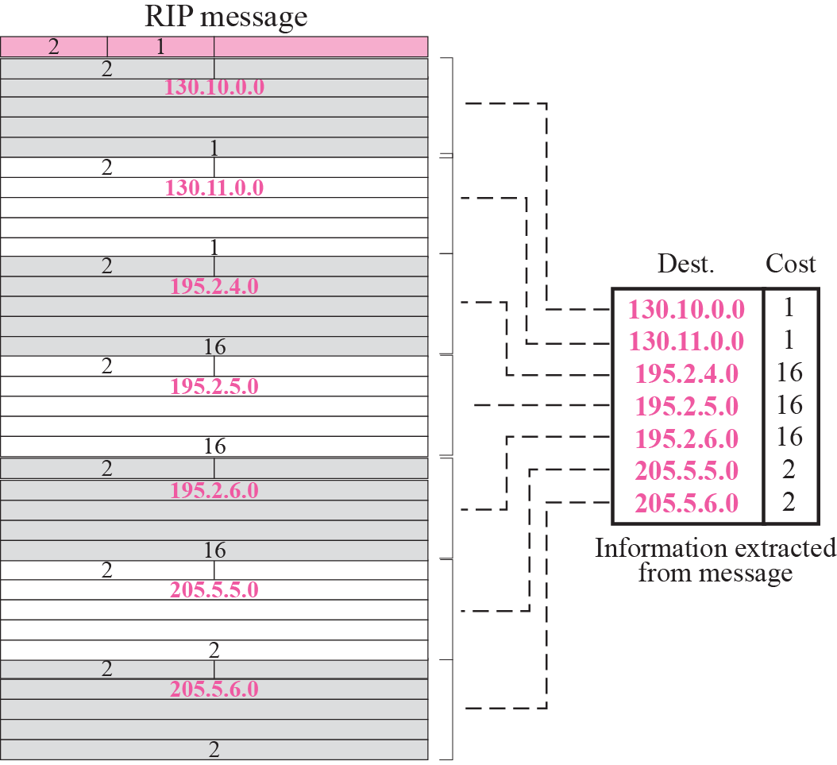

Slide 36
Routing with RIP
Initialization: Send a request packet (command = 1, address family=0..0) on all interfaces:
RIPv1 uses broadcast (255.255.255.255) if possible,
RIPv2 uses multicast address 224.0.0.9, if possible
requesting routing tables from neighboring routers
Request received: Routers that receive above request send their entire routing table
Response received: Update the routing table
Regular routing updates: Every 30 seconds, send all or part of the routing tables to every neighbor in an response message
Triggered Updates: Whenever the metric for a route change, send entire routing table.

Slide 37
RIP Timers
Periodic Update: 30 seconds with random jitter to avoid table synchronization.
Expiration Timer (Timeout, invalidation timer): 180 seconds
Reset to initial value when an update received
Garbage collection/Flush Timer: 240 seconds. Routes will be removed from routing table when the timer expired.
Holddown Timer: 180 seconds. Set when an update with a hop count higher than the metric recorded in the route table.
Flush timer
Expiration timer
Set metric to 16
Remove from RT

Slide 38
RIP Security
Issue: Sending bogus routing updates to a router
RIPv1: No protection
RIPv2: Simple authentication scheme
2: plaintext password

Slide 39
RIP Problems
RIP takes a long time to stabilize
Even for a small network, it takes several minutes until the routing tables have settled after a change
RIP has all the problems of distance vector algorithms, e.g., count-to-Infinity
RIP uses split horizon to avoid count-to-infinity
The maximum path in RIP is 15 hops

Slide 40
Distance Vector vs. Link State Routing
With distance vector routing, each node has information only about the next hop:
Node A: to reach F go to B
Node B: to reach F go to D
Node D: to reach F go to E
Node E: go directly to F
Distance vector routing makes poor routing decisions if directions are not completely correct (e.g., because a node is down).
If parts of the directions incorrect, the routing may be incorrect until the routing algorithms has re-converged.
A
B
C
D
E
F

Slide 41
Distance Vector vs. Link State Routing
In link state routing, each node has a complete map of the topology
If a node fails, each node can calculate the new route
Difficulty: All nodes need to have a consistent view of the network
A
B
C
A
B
C
A
B
C
D
E
F
D
E
F
D
E
F
A
B
C
D
E
F
A
B
C
A
B
C
A
B
C
D
E
F
D
E
F
D
E
F

Slide 42
Link State Routing: Properties
Each node requires complete topology information
Link state information must be flooded to all nodes
Guaranteed to converge

Slide 43
Link State Routing: Basic Principles
Each router establishes a relationship (“adjacency”) with its neighbors
Each router generates link state advertisements (LSAs) which are distributed to all routers
LSA = (link id, state of the link, cost, neighbors of the link)
Each router maintains a database of all received LSAs (topological database or link state database), which describes the network has a graph with weighted edges
Each router uses its link state database to run a shortest path algorithm (Dijikstra’s algorithm) to produce the shortest path to each network

Slide 44
Operation Of A Link State Routing Protocol
IP Routing Table
Received LSAs
Link State Database
Dijkstra’s
Algorithm
LSAs are flooded to other interfaces

Slide 45
Dijkstra’s Shortest Path Algorithm for a Graph
Input: Graph (N,E) with N : the set of nodes and
E : the set of edges
d_{vw} : link cost (d_{vw} = infinity if (v,w) ∉ E, d_{vv} = 0)
s : source node.
Output: D_{n} cost of the least-cost path from node s to node n
M = {s};
for each n ∉ M
D_{n} = d_{sn};
while (M ≠ all nodes) do
Find w ∉ M for which D_{w} = min{D_{j} ; j ∉ M};
Add w to M;
for each n ∉ M
D_{n} = min_{w} [ D_{n}, D_{w} + d_{wn} ];
Update route;
enddo

Slide 46
Introduction to OSPF Concepts
Metric based on Cost (Bandwidth)
Hello Protocol
Steps to OSPF Operation
DR/BDR
OSPF Network Types

Slide 47
Brief History
1987 – Initial development of OSPF began by IETF OSPF working group
1989 – OSPFv1 published in RFC 1131. OSPFv1 was experimental and was never deployed.
1991 – OSPFv2 introduced in RFC 1247 by John Moy. It is classless by design.
1998 – OSPFv2 specification updated in RFC 2328 which remains the current RFC for OSPF
1999 – OSPFv3 for IPv6 published in RFC 2740
2008 – OSPFv3 updated in RFC 5340

Slide 48
Features of OSPFv2
Classless
Efficient – no periodic updates. Use the SPF algorithm to choose the best path
Fast convergence
Scalable – Hierarchical
Secure – Support MD5 authentication

Slide 49
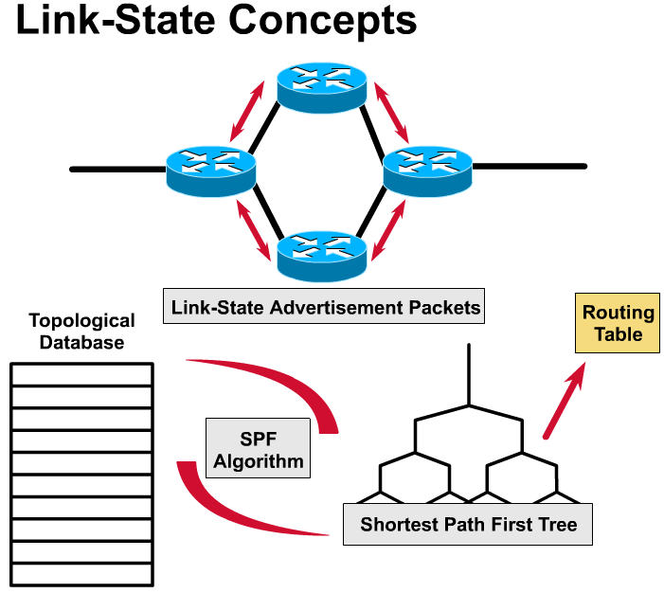
Link State
1 – Flooding of link-state information
The first thing that happens is that each node, router, on the network announces its own piece of link-state information to other all other routers on the network. This includes who their neighboring routers are and the cost of the link between them.
Example: “Hi, I’m RouterA, and I can reach RouterB via a T1 link and I can reach RouterC via an Ethernet link.”
Each router sends these announcements to all of the routers in the network.

Slide 50
Link State
1 – Flooding of link-state information
3 – SPF Algorithm
2 – Building a Topological Database
2. Building a Topological Database
Each router collects all of this link-state information from other routers and puts it into a topological database.
3. Shortest-Path First (SPF), Dijkstra’s Algorithm
Using this information, the routers can recreate a topology graph of the network.

Slide 51
Link State
1 – Flooding of link-state information
5 – Routing Table
3 – SPF Algorithm
2 – Building a Topological Database
4 – SPF Tree
4. Shortest Path First Tree
This algorithm creates an SPF tree, with the router making itself the root of the tree and the other routers and links to those routers, the various branches.
5. Routing Table
Using this information, the router creates a routing table.

Slide 52
Link State Concepts
1 – Flooding of link-state information
5 – Routing Table
3 – SPF Algorithm
2 – Building a Topological Database
4 – SPF Tree
How does the SPF algorithm create an SPF Tree?
Let’s take a look!
This is extra Information.

Slide 53
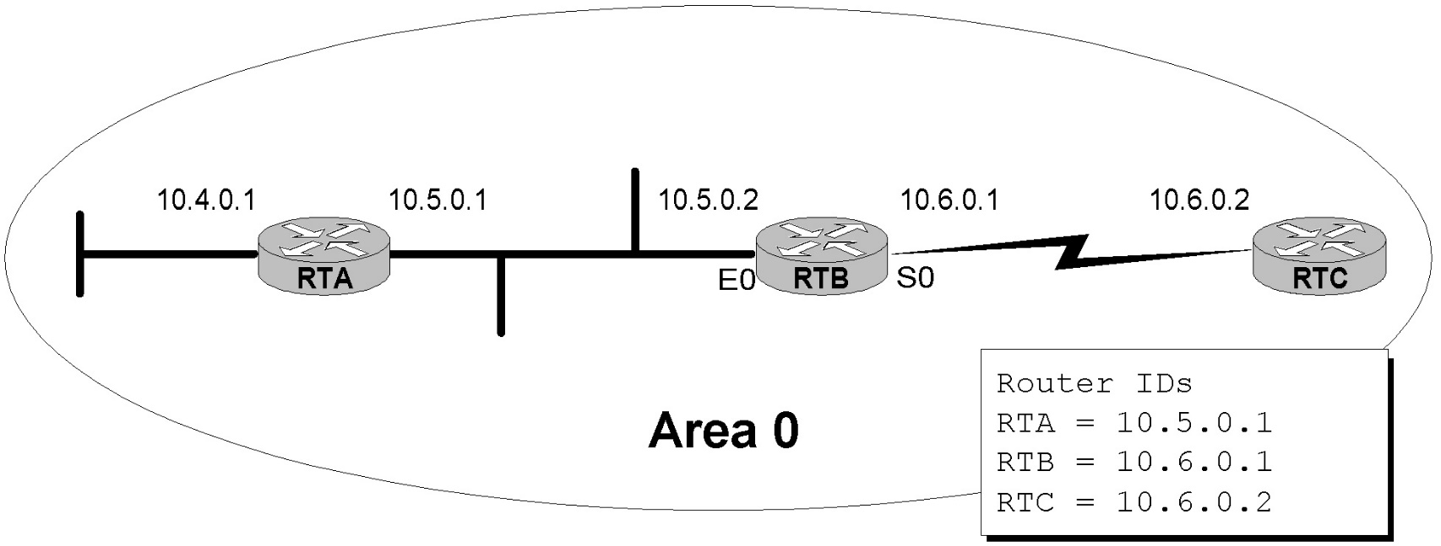
Terminology
Router ID – Used to identify the routers in the OSPF network
IP address configured with the OSPF router-id command (extra)
Highest loopback address (configuration coming)
Highest active IP address (any IP address)
Loopback address has the advantage of never going down, thus diminishing the possibility of having to re-establish adjacencies. (more in a moment)

Slide 54
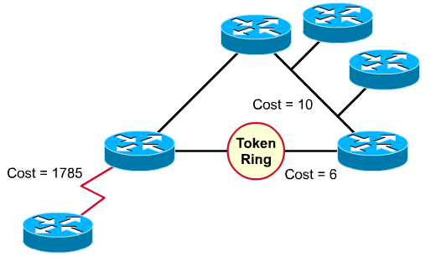
Terminology
Link: Interface on a router
Link state: Description of an interface and of its relationship to its neighboring routers, including:
IP address/mask of the interface,
The type of network it is connected to
The routers connected to that network
The metric (cost) of that link
The collection of all the link-states would form a link-state database.

Slide 55
How to Represent a Topology
B
(A, B, 15)
(A, C, 2)
(A, D, 5)
(B, E, 2)
(C, D, 2)
(D, E, 10)
15
2
A
2
C
E
2
5
10
D
Notes:
A

Slide 56
Topology
(A, B, 11.0.0.0/8, 15)
(A, C, 12.0.0.0/8, 2)
(A, D, 13.0.0.0/8, 5)
(A, --, 10.0.0.0/8, 2)
(B, E, 15.0.0.0/8,2)
(B, --, 14.0.0.0/8, 2)
(C, D, 16.0.0.0/8, 2)
(C, --, 17.0.0.0/8, 2)
(D, E, 18.0.0.0/8, 10)
(D, --, 19.0.0.0/8, 2)
(E, --, 20.0.0.0/8, 2)
14.0.0.0/8
2
11.0.0.0/8
15.0.0.0/8
12.0.0.0/8
17.0.0.0/8
20.0.0.0/8
2
2
2
10.0.0.0/8
16.0.0.0/8
13.0.0.0/8
18.0.0.0/8
2
19.0.0.0/8
Notes:
A

Slide 57
Extra: Simplified Link State Example
RouterB:
Connected to RouterA on network 11.0.0.0/8, cost of 15
Connected to RouterE on network 15.0.0.0/8, cost of 2
Has a “leaf” network 14.0.0.0/8, cost of 15
RouterC:
Connected to RouterA on network 12.0.0.0/8, cost of 2
Connected to RouterD on network 16.0.0.0/8, cost of 2
Has a “leaf” network 17.0.0.0/8, cost of 2
RouterD:
Connected to RouterA on network 13.0.0.0/8, cost of 5
Connected to RouterC on network 16.0.0.0/8, cost of 2
Connected to RouterE on network 18.0.0.0/8, cost of 2
Has a “leaf” network 19.0.0.0/8, cost of 2
RouterE:
Connected to RouterB on network 15.0.0.0/8, cost of 2
Connected to RouterD on network 18.0.0.0/8, cost of 10
Has a “leaf” network 20.0.0.0/8, cost of 2
RouterA’s Topological Data Base (Link State Database)
All other routers flood their own link state information to all other routers.
RouterA gets all of this information and stores it in its LSD (Link State Database).
Using the link state information from each router, RouterC runs Dijkstra algorithm to create a SPT. (next)

Slide 58
Extra: Simplified Link State Example
You are RouterA and you have exchanged “Hellos” with:
RouterB on your network 11.0.0.0/8 with a cost of 15,
RouterC on your network 12.0.0.0/8 with a cost of 2
RouterD on your network 13.0.0.0/8 with a cost of 5
Have a “leaf” network 10.0.0.0/8 with a cost of 2
This is your link-state information, which you will flood to all other routers.
All other routers will also flood their link state information. (OSPF: only within the area)
“Leaf” 10.0.0.0/8
11.0.0.0/8
2
12.0.0.0/8
13.0.0.0/8

Slide 59
Link State information from RouterB
We now get the following link-state information from RouterB:
Connected to RouterA on network 11.0.0.0/8, cost of 15
Connected to RouterE on network 15.0.0.0/8, cost of 2
Have a “leaf” network 14.0.0.0/8, cost of 15
14.0.0.0/8
2
11.0.0.0/8
15.0.0.0/8
Now, RouterA attaches the two graphs…
14.0.0.0/8
2
11.0.0.0/8
14.0.0.0/8
11.0.0.0/8
15.0.0.0/8
+
2
=
10.0.0.0/8
12.0.0.0/8
15.0.0.0/8
10.0.0.0/8
12.0.0.0/8
2
2
13.0.0.0/8
13.0.0.0/8
Notes:
A

Slide 60
Link State information from RouterC
We now get the following link-state information from RouterC:
Connected to RouterA on network 12.0.0.0/8, cost of 2
Connected to RouterD on network 16.0.0.0/8, cost of 2
Have a “leaf” network 17.0.0.0/8, cost of 2
12.0.0.0/8
17.0.0.0/8
2
16.0.0.0/8
14.0.0.0/8
Now, RouterA attaches the two graphs…
2
11.0.0.0/8
15.0.0.0/8
17.0.0.0/8
14.0.0.0/8
10.0.0.0/8
12.0.0.0/8
+
2
2
16.0.0.0/8
2
11.0.0.0/8
15.0.0.0/8
13.0.0.0/8
=
12.0.0.0/8
17.0.0.0/8
10.0.0.0/8
2
16.0.0.0/8
13.0.0.0/8
Notes:
A

Slide 61
Link State information from RouterD
We now get the following link-state information from RouterD:
Connected to RouterA on network 13.0.0.0/8, cost of 5
Connected to RouterC on network 16.0.0.0/8, cost of 2
Connected to RouterE on network 18.0.0.0/8, cost of 2
Have a “leaf” network 19.0.0.0/8, cost of 2
16.0.0.0/8
13.0.0.0/8
18.0.0.0/8
2
19.0.0.0/8
Now, RouterA attaches the two graphs…
14.0.0.0/8
2
14.0.0.0/8
2
11.0.0.0/8
15.0.0.0/8
18.0.0.0/8
11.0.0.0/8
15.0.0.0/8
12.0.0.0/8
17.0.0.0/8
+
10.0.0.0/8
2
19.0.0.0/8
12.0.0.0/8
10.0.0.0/8
17.0.0.0/8
2
16.0.0.0/8
=
2
16.0.0.0/8
13.0.0.0/8
13.0.0.0/8
18.0.0.0/8
2
19.0.0.0/8
Notes:
A

Slide 62
Link State information from RouterE
We now get the following link-state information from RouterE:
Connected to RouterB on network 15.0.0.0/8, cost of 2
Connected to RouterD on network 18.0.0.0/8, cost of 10
Have a “leaf” network 20.0.0.0/8, cost of 2
15.0.0.0/8
20.0.0.0/8
2
Now, RouterA attaches the two graphs…
18.0.0.0/8
14.0.0.0/8
2
11.0.0.0/8
15.0.0.0/8
14.0.0.0/8
2
12.0.0.0/8
17.0.0.0/8
+
20.0.0.0/8
11.0.0.0/8
15.0.0.0/8
10.0.0.0/8
2
16.0.0.0/8
2
20.0.0.0/8
12.0.0.0/8
17.0.0.0/8
10.0.0.0/8
13.0.0.0/8
18.0.0.0/8
2
2
16.0.0.0/8
2
19.0.0.0/8
13.0.0.0/8
18.0.0.0/8
2
19.0.0.0/8
Notes:
A

Slide 63
Topology
Using the topological information we listed, RouterA has now built a complete topology of the network.
The next step is for the link-state algorithm to find the best path to each node and leaf network.
14.0.0.0/8
2
11.0.0.0/8
15.0.0.0/8
12.0.0.0/8
10.0.0.0/8
17.0.0.0/8
20.0.0.0/8
2
2
2
16.0.0.0/8
13.0.0.0/8
18.0.0.0/8
2
19.0.0.0/8
Notes:
A

Slide 64
Extra: Simplified Link State Example
RouterB:
Connected to RouterA on network 11.0.0.0/8, cost of 15
Connected to RouterE on network 15.0.0.0/8, cost of 2
Has a “leaf” network 14.0.0.0/8, cost of 15
RouterC:
Connected to RouterA on network 12.0.0.0/8, cost of 2
Connected to RouterD on network 16.0.0.0/8, cost of 2
Has a “leaf” network 17.0.0.0/8, cost of 2
RouterD:
Connected to RouterA on network 13.0.0.0/8, cost of 5
Connected to RouterC on network 16.0.0.0/8, cost of 2
Connected to RouterE on network 18.0.0.0/8, cost of 2
Has a “leaf” network 19.0.0.0/8, cost of 2
RouterE:
Connected to RouterB on network 15.0.0.0/8, cost of 2
Connected to RouterD on network 18.0.0.0/8, cost of 10
Has a “leaf” network 20.0.0.0/8, cost of 2
RouterA’s Topological Data Base (Link State Database)

Slide 65
Choosing the Best Path
Using the link-state algorithm RouterA can now proceed to find the shortest path to each leaf network.
14.0.0.0/8
2
11.0.0.0/8
15.0.0.0/8
12.0.0.0/8
10.0.0.0/8
17.0.0.0/8
20.0.0.0/8
2
2
2
16.0.0.0/8
13.0.0.0/8
18.0.0.0/8
2
19.0.0.0/8
Notes:
A

Slide 66
Choosing the Best Path
Now RouterA knows the best path to each network, creating an SPT (Shortest Path Tree).
14.0.0.0/8
2
11.0.0.0/8
15.0.0.0/8
12.0.0.0/8
10.0.0.0/8
17.0.0.0/8
20.0.0.0/8
2
2
16.0.0.0/8
13.0.0.0/8
18.0.0.0/8
2
19.0.0.0/8
Notes:
A

Slide 67
SPT Results Get Put into the Routing Table
RouterA’s Routing Table
10.0.0.0/8 connected e0
11.0.0.0/8 connected s0
12.0.0.0/8 connected s1
13.0.0.0/8 connected s2
14.0.0.0/8 17 s0
15.0.0.0/8 17 s1
16.0.0.0/8 4 s1
17.0.0.0/8 4 s1
18.0.0.0/8 14 s1
19.0.0.0/8 6 s1
20.0.0.0/8 16 s1
14.0.0.0/8
2
11.0.0.0/8
15.0.0.0/8
12.0.0.0/8
10.0.0.0/8
17.0.0.0/8
20.0.0.0/8
2
2
16.0.0.0/8
13.0.0.0/8
18.0.0.0/8
2
19.0.0.0/8

Slide 68
OSPF’s Metric is Cost (Bandwidth)
RFC 2328, OSPF version 2, J. Moy
“A cost is associated with the output side of each router interface. This cost is configurable by the system administrator. The lower the cost, the more likely the interface is to be used to forward data traffic.”
RFC 2328 does not specify any values for cost.
Bay and some other vendors use a default cost of 1 on all interfaces, essentially making the OSPF cost reflect hop counts.

Slide 69
OSPF’s Metric is Cost (Bandwidth)
Cisco: Cost = Bandwidth
Cisco uses a default cost of 10⁸/bandwidth
Default bandwidth of the interface (bandwidth command)
10⁸ (100,000,000) as the reference bandwidth: This is used so that the faster links (higher bandwidth) have lower costs.
Routing metrics, lower the cost the better the route.
I.e. RIP: 3 hops is better than 10 hops
Extra: The reference bandwidth can be modified to accommodate networks with links faster than 100,000,000 bps (100 Mbps). See ospf auto-cost reference-bandwidth command.
Cost of a route is the cumulative costs of the outgoing interfaces from this router to the network.

Slide 70
OSPF’s Metric is Cost (Bandwidth)
Cisco default interface costs:
56-kbps serial link = 1785
64-kbps serial link = 1562 128-kbps serial link = 781
T1 (1.544-Mbps serial link) = 64
E1 (2.048-Mbps serial link) = 48
4-Mbps Token Ring = 25
Ethernet = 10
16-Mbps Token Ring = 6
Fast Ethernet = 1
Problem: Gigabit Ethernet and faster = 1
Notes:
Cisco routers default to T1 (1.544 Mbps) on all serial interfaces and require manual modification with the bandwidth command.
ospf auto-cost reference-bandwidth reference-bandwidth can be used to modify the reference-bandwidth for higher speed interfaces
Cost = 100,000,000/Bandwidth

Slide 71
OSPF’s Metric is Cost (Bandwidth)
Few final notes
For serial links, if it is not a T1 line, use the bandwidth command to configure the interface to the right bandwidth
Both sides of the link should have the same bandwidth value
If you use the command ospf auto-cost reference-bandwidth reference-bandwidth, configure all of the routers to use the same value.

Slide 72
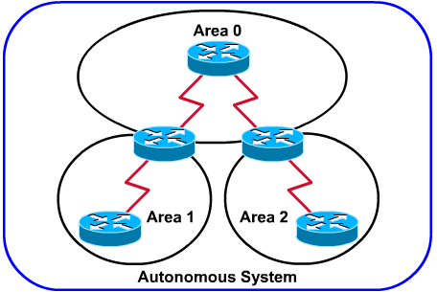
Terminology
Single Area OSPF uses only one area, usually Area 0

Slide 73
OSPF Areas
Group of contiguous nodes/networks
Per area topology DB
Invisible outside the area
Reduces routing traffic
Backbone Area is contiguous
All others areas must connect to the backbone
Virtual Links
Area 2
Area 3
Area 0
Backbone Area
Area 1
Area 4
Notes:
27
Router ID: A 32-bit number assigned to each router running the OSPF protocol. This number uniquely identifies the router within an Autonomous System. Router use this number to identify themselves when generating updates.
Neighboring routers: Two routers that have interfaces to a common network. On multi-access networks, neighbors are dynamically discovered by OSPFs Hello Protocol.
Adjacency: A relationship formed between selected neighboring routers for the purpose of exchanging routing information. Not every pair of neighboring routers become adjacent.
Link state advertisement: Describes the local state of the router or network. This includes the state of the router’s interfaces and adjacencies. Each link state advertisement is flooded throughout the routing domain. The collected link state advertisements of all routers and networks forms the protocol’s topological database.
Hello protocol: The part of the OSPF protocol used to establish and maintain neighboring relationships. On multi-access networks the Hello Protocol can also dynamically discover neighboring routers.
Designated router: Each multi-access network that has at least two attached routers has a Designated Router. The Designated Router generates a link state advertisement for the multi-access network and has other special responsibilities in the running of the protocol. The Designated Router is elected by the Hello Protocol.

Slide 74
An OSPF network can be divided into sub-domains called areas. An area is a logical collection of OSPF networks, routers, and links that have the same area identification. A router within an area must maintain a topological database for the area to which it belongs. The router doesn't have detailed information about network topology outside of its area, thereby reducing the size of its database.

Slide 75
Router Classification
IR
Area 2
Area 3
ABR/BR
Area 0
Internal Router (IR)
Area Border Router (ABR)
Backbone Router (BR)
Autonomous System Border Router (ASBR)
ASBR
IR/BR
To another AS
Area 1
Notes:
32

Slide 76
OSPF Route Types
Area 2
Area 0
Area 3
ABR
Intra-Area Route
All routes within an area
Inter-Area Route
Routes announced from area to another by an ABR
External Route
Routes imported into OSPF from another protocol or Static routes
ASBR
To Another AS

Slide 77
Topology/Links-State DB
A router has a separate DB for each area it belongs
All routers within an area have an identical DB
SPF calculation is done separately for each area
LSA flooding is limited to the particular area
Notes:
30

Slide 78
OSPF Packet Format
MAC Hdr
IP Hdr
OSPF Hdr
OSPF type-specific Data
MAC Header
Src – MAC addr of sending interface
Dst – 0100:5E00:0005 or 0100:5E00:0006
Type – 0x0800
IP Header
Src – IP addr of sending interface
Dst – 224.0.0.5 or 224.0.0.6
Protocol – 89
OSPF Header
Version
Type
Router ID
Area ID
Notes:
01:00:5E:00:00:00 - 01:00:5E:7F:FF:FF 0x0800 IPv4 Multicast (RFC 1112), insert the low 23 Bits of the multicast IPv4 Address into the Ethernet Address (RFC 7042 2.1.1.)
33:33:xx:xx:xx:xx 0x86DD IPv6 Multicast (RFC 2464), insert the low 32 Bits of the multicast IPv6 Address into the Ethernet Address (RFC 7042 2.3.1.)
224.0.0.5 The Open Shortest Path First (OSPF) All OSPF Routers address is used to send Hello packets to all OSPF routers on a network segment.
224.0.0.6 The OSPF All Designated Routers ""(DR)"" address is used to send OSPF routin`g information to designated routers on a network segment.

Slide 79
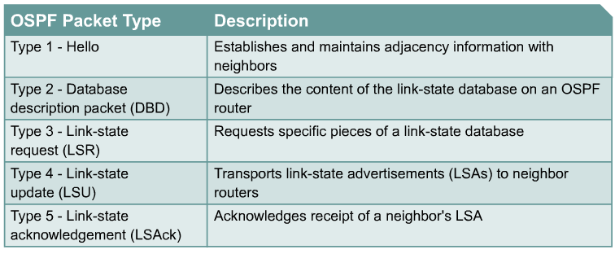
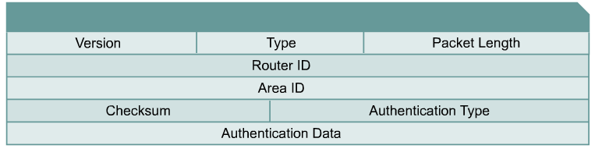
OSPF Packet Types

Slide 80
OSPF Packet Format
2: current version is OSPF V2
Message types:
1: Hello (tests reachability)
2: Database description
3: Link Status request
4: Link state update
5: Link state acknowledgement
ID of the Area from which the packet originated
0: no authentication
1: Cleartext password
2: MD5 checksum
(added to end packet)
Standard IP checksum taken over entire packet
Authentication passwd = 1: 64 cleartext password
Authentication passwd = 2: 0x0000 (16 bits)
KeyID (8 bits)
Length of MD5 checksum (8 bits) Nondecreasing sequence number (32 bits)
Prevents replay attacks

Slide 81
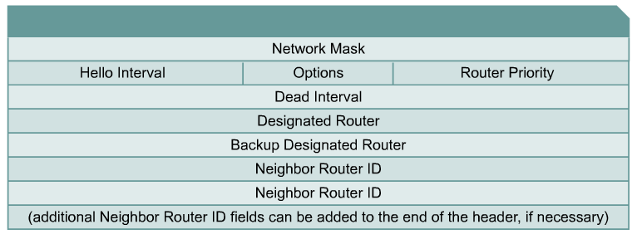
OSPF Hello Protocol
Hello sub-protocol is intended to perform the following tasks within OSPF:
Dynamic neighbor discovery
Detect unreachable neighbors
Ensure two-way communications between neighbors
Ensure correctness of basic interface parameters between neighbors
Provide necessary information for the election of the Designated and Backup Designated routers on a LAN segment (coming)

Slide 82
OSPF Hello Protocol
OSPF routers send Hellos on OSPF enabled interfaces:
Default every 10 seconds on multi-access and point-to-point segments
Default every 30 seconds on NBMA segments (Frame Relay, X.25, ATM)
Most cases OSPF Hello packets are sent as multicast to ALLSPFRouters (224.0.0.5)
HelloInterval - Cisco default = 10 seconds or 30 seconds and can be changed with the command ip ospf hello-interval.
RouterDeadInterval - The period in seconds that the router will wait to hear a Hello from a neighbor before declaring the neighbor down.
Cisco uses a default of four-times the HelloInterval (4 x 10 sec. = 40 seconds, 120 secconds for NBMA) and can be changed with the command ip ospf dead-interval.
Note: For routers to become adjacent, the Hello, DeadInterval and network types must be identical between routers or Hello packets get dropped!

Slide 83
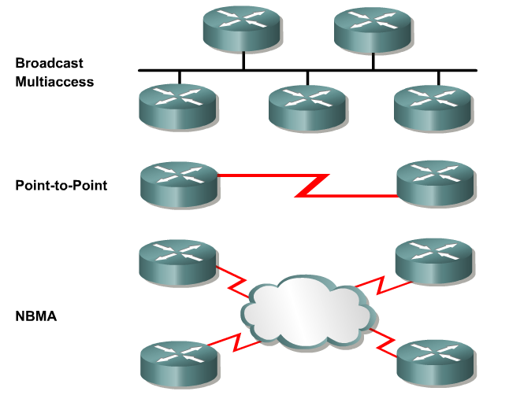
Network Types – more later
Network Type | Example
Broadcast Multiaccess | Ethernet, Token Ring, or FDDI
Non-Broadcast Multiaccess | Frame Relay, X25
Point-to-point | PPP, HDLC
Point-to-multipoint | Configured by an administrator

Slide 84
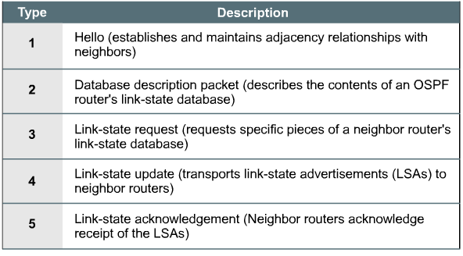
OSPF packet types
OSPF Type-2 (DBD)
OSPF Type-3 (LSR)
OSPF Type-4 (LSU)
OSPF Type-5 (LSAck)

Slide 85
Steps to OSPF Operation
Establish router adjacencies
Elect a designated router and a backup designated router
Discover routes
Select appropriate route to use
Maintain routing information
Down
Init
Two-way
ExStart
Exchange
Loading
Full Adjacency

Slide 86
Steps to OSPF Operation with States
1. Establishing router adjacencies (Routers are adjacent)
Down State – No Hello received
Init State – Hello received, but not with this router’s Router ID
“Hi, my name is Carlos.” “Hi, my name is Maria.”
Two-way State – Hello received, and with this router’s Router ID
“Hi, Maria, my name is Carlos.” “Hi, Carlos, my name is Maria.”
2. Electing DR and BDR – Multi-access (broadcast) segments only
ExStart State with DR and BDR
Two-way State with all other routers
3. Discovering Routes
ExStart State
Exchange State
Loading State
Full State (Routers are “fully adjacent”)
4. Calculating the Routing Table
5. Maintaining the LSDB and Routing Table

Slide 87
1. Establishing Adjacencies
Initially, an OSPF router interface is in the down state.
An OSPF interface can transition back to this state if it has not received a Hello packet from a neighbor within the RouterDeadInterval time (40 seconds unless NBMA, 120 seconds).
In the down state, the OSPF process has not exchanged information with any neighbor.
OSPF is waiting to enter the init state.
An OSPF router tries to form an adjacency with at least one neighbor for each IP network it’s connected to.

Slide 88
1. Establishing Adjacencies
The process of establishing adjacencies is asymmetric, meaning the states between two adjacent routers may be different as they both transition to full state.
RTB perspective and assuming routers are configured correctly.
Trying to start a relationship and wanting to enter the init state or really the two-way-state
RTB begins multicasts OSPF Hello packets (224.0.0.5, AllOSPFRouters), advertising its own Router ID.
224.0.0.5: All OSPF routers should be able to transmit and listen to this address.

Slide 89
1. Establishing Adjacencies
Router ID = Highest loopback address else highest active IP address.
Loopback address has the advantage of never going down, thus diminishing the possibility of having to re-establish adjacencies. (more in a moment)
Use private ip addresses for loopbacks, so you do not inadvertently advertise a route to a real network that does not exist on your router.
For routers to become adjacent, the Hello, DeadInterval and network types must be identical between routers or Hello packets get dropped!

Slide 90
1. Establishing Adjacencies
Hello 10.6.0.1 10.5.0.1
Hello 10.6.0.1
2-way
Down
Init
2-way
Down
Init
Hello 10.5.0.1
Hello 10.5.0.1 10.6.0.1
Down State - Init State – Two Way State
Down State - OSPF routers send Type 1 Hello packets at regular intervals (10 sec.) to establish neighbors.
When a router (sends or) receives its first Hello packet, it enters the init state, indicating that the Hello packet was received but did not contain the Router ID of the receiving router in the list of neighbors, so two-way communications is not yet ensured.
As soon as the router sends a Hello packet to the neighbor with its RouterID and the neighbor sends a Hello packet packet back with that Router ID, the router’s interface will transition to the two-way state.
Now, the router is ready to take the relationship to the next level.

Slide 91
1. Establishing Adjacencies
Hello 10.6.0.1 10.5.0.1
Hello 10.6.0.1
2-way
Down
Init
2-way
Down
Init
Hello 10.5.0.1
Hello 10.5.0.1 10.6.0.1
From Init state to the Two-way state
RTB receives Hello packets from RTA and RTC (its neighbors), and sees its own Router ID (10.6.0.1) in the Neighbor ID field.
RTB declares takes the relationship to a new level, and declares a two-way state between itself and RTA, and itself and RTC.
As soon as the router sends a Hello packet to the neighbor with its RouterID and the neighbor sends a Hello packet packet back with that Router ID, the router’s interface will transition to the two-way state.
Now, the router is ready to take the relationship to the next level.

Slide 92
1. Establishing Adjacencies
Two-way state
RTB now decides who to establish a “full adjacency” with depending upon the type of network that the particular interfaces resides on.
Note: The term adjacency is used to both describe routers reaching 2-way state and when they reach full-state. Not to go overboard on this, but technically OSPF routers are adjacent when the FSM reaches full-state and IS-IS is considered adjacent when the FSM reaches 2-way state.
Two-way state to ExStart state
If the interface is on a point-to-point link, the routers becomes adjacent with its sole link partner (aka “soul mates”), and take the relationship to the next level by entering the ExStart state. (coming soon)
Remaining in the two-way state
If the interface is on a multi-access link (Ethernet, Frame Relay, …) RTB must enter an election process to see who it will establish a full adjacency with, and remains in the two-way state. (Next!)

Slide 93
Steps to OSPF Operation with States
1. Establishing router adjacencies (Routers are adjacent)
Down State – No Hello received
Init State – Hello received, but not with this router’s Router ID
“Hi, my name is Carlos.” “Hi, my name is Maria.”
Two-way State – Hello received, and with this router’s Router ID
“Hi, Maria, my name is Carlos.” “Hi, Carlos, my name is Maria.”
2. Electing DR and BDR – Multi-access (broadcast) segments only
ExStart State with DR and BDR
Two-way State with all other routers
3. Discovering Routes
ExStart State
Exchange State
Loading State
Full State (Routers are “fully adjacent”)
4. Calculating the Routing Table
5. Maintaining the LSDB and Routing Table

Slide 94
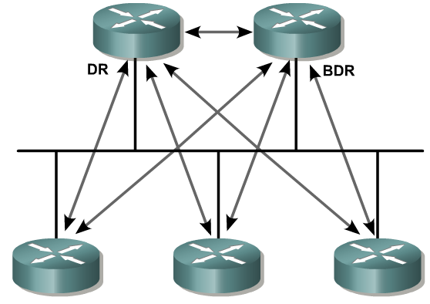
Electing the DR and BDR
On multi-access, broadcast links (Ethernet), a DR and BDR (if there is more than one router) need to be elected.
DR - Designated Router
BDR – Backup Designated Router
DR’s serve as collection points for Link State Advertisements (LSAs) on multi-access networks
A BDR back ups the DR.
If the IP network is multi-access, the OSPF routers will elect one DR and one BDR
Without a DR, the formation of an adjacency between every attached router would create many unnecessary LSA (Link State Advertisements), n(n-1)/2 adjacencies.
Flooding on the network itself would be chaotic.

Slide 95
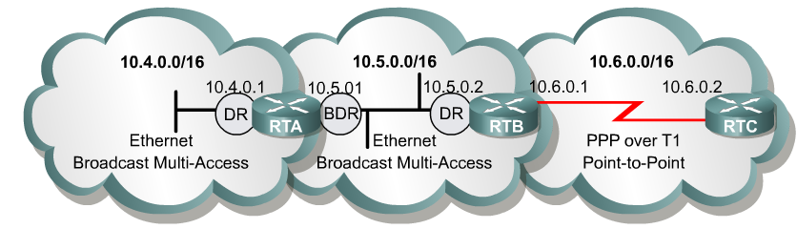
Electing the DR and BDR
Router with the highest Router ID is elected the DR, next is BDR.
But like other elections, this one can be rigged.
The router’s priority field can be set to either ensure that it becomes the DR or prevent it from being the DR.
Rtr(config-if)# ip ospf priority <0-255>
Higher priority becomes DR/BDR
Default = 1
0 = Ineligible to become DR/BDR
The router can be assigned a priority between 0 and 255, with 0 preventing this router from becoming the DR (or BDR) and 255 ensuring at least a tie. (The highest Router ID would break the tie.)

Slide 96
Electing the DR and BDR
All other routers, “DROther”, establish adjacencies with only the DR and BDR.
DRother routers multicast LSAs to only the DR and BDR
(224.0.0.6 - all DR routers)
DR sends LSA to all adjacent neighbors (DROthers)
(224.0.0.5 - all OSPF routers)
Backup Designated Router - BDR
Listens, but doesn’t act.
If LSA is sent, BDR sets a timer.
If timer expires before it sees the reply from the DR, it becomes the DR and takes over the update process.
The process for a new BDR begins.

Slide 97
Electing the DR and BDR
A new router enters the network:
Once a DR is established, a new router that enters the network with a higher priority or Router ID it will NOT become the DR or BDR. (Bug in early IOS 12.0)
Regardless of the priority or Router ID, that router will become a DROther.
If DR fails, BDR takes over as DR and selection process for new BDR begins.

Slide 98
Clarifications
Hello packets are still exchanged between all routers on a multi-access segment (DR, BDR, DROthers,….) to maintain neighbor adjacencies.
OSPF LSA packets (coming) are packets which are sent from the BDR/DROthers to the DR, and then from the DR to the BDR/DROthers. (The reason for a DR/BDR.)
Normal routing of IP packets still takes the lowest cost route, which might be between two DROthers.

Slide 99
Steps to OSPF Operation with States - Extra
1. Establishing router adjacencies
Down State – No Hello received
Init State – Hello received, but not with this router’s Router ID
“Hi, my name is Carlos.” “Hi, my name is Maria.”
Two-way State – Hello received, and with this router’s Router ID
“Hi, Maria, my name is Carlos.” “Hi, Carlos, my name is Maria.”
2. Electing DR and BDR – Multi-access (broadcast) segments only
ExStart State with DR and BDR
Two-way State with all other routers
3. Discovering Routes
ExStart State
Exchange State
Loading State
Full State
4. Calculating the Routing Table
5. Maintaining the LSDB and Routing Table

Slide 100
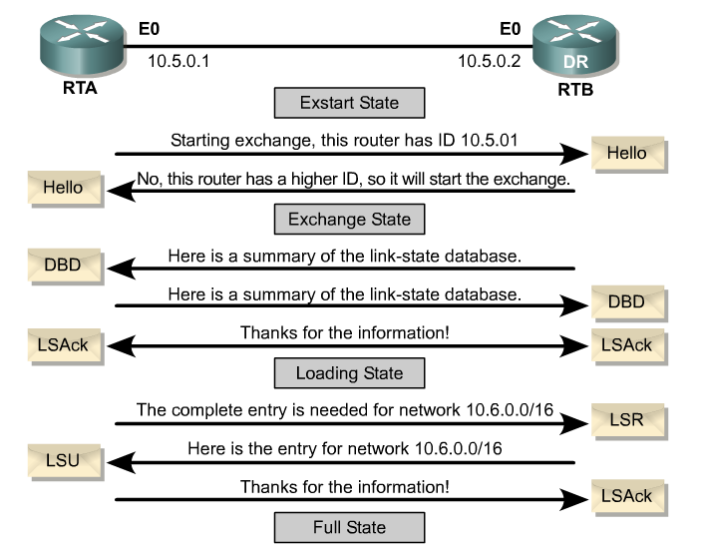
Steps to OSPF Operation with States Discovering Routes and Reaching Full State

Slide 101
ExStart State – the explanation
ExStart State
This state starts the LSDB (Link State Data Base) synchronization process.
This will prepare for initial database exchange.
Routers are now ready to exchange routing information.
Between routers on a point-to-point network
On a multi-access network between the DRothers and the DR and BDR.
Formally, routers in ExStart state are characterized as adjacent, but have not yet become “fully adjacent” as they have not exchanged database information.
But who goes first in the exchange?
ExStart is established by exchanging OSPF Type-2 DBD (Database Description) packets
Purpose of ExStart is to establish a “master/slave relationship” between the two routers decided by the higher router id.
Once the roles are established they enter the Exchange state.

Slide 102
OSPF Database Description Packet Format
Interface MTU
Options
00000I M MS
DD Sequence #
LSA Headers
I – Initial bit M – More bit MS – 1: master, 0: slave
Sequence #: Set by master in the 1st DD packet, and incremented in subsequent packets

Slide 103
Exchange State – the explanation
Routers exchange one or more Type-2 DBDs (Database Description) packets, which is a summary of the link-state database
send LSAcks to verify
Routers compare these DBDs with information in its own database.
When a DBD packet is received the router looks through the LSA (Link State Advertisement) headers and identifies LSAs that are not in the router’s LSDB or are a different version from its LSDB version (older or newer).
If the LSA is not in its LSDB or the LSA is a more recent version, the router adds an entry to its Link State Request list.
This process ends when both routers stop have sent and received acknowledgements for all their DBD packets – that is they have successfully sent all their DBD packets to each other.

Slide 104
Exchange State – the explanation
Exchange State
If a router has entries in its Link State Request list, meaning that it needs additional information from the other router for routes that are not in its LSDB or has more recent versions, then it enters the loading state.
If there are no entries in its Link State Request list, than the router’s interface can transition directly to full state.
Complete routing information is exchanged in the loading state, discussed next.

Slide 105
Loading State - the explanation
Loading State
If a router has entries in its Link State Request list, meaning that it needs additional information from the other router for routes that are not in its LSDB or has more recent versions, then it enters the loading state.
The router needing additional information sends LSR (Link State Request) packets using LSA information from its LSR list.

Slide 106
Loading State - the explanation
Loading State
The other routers replies by sending the requested LSAs in the Link State Update (LSU) packet.
The receiving router sends LSAck to acknowledge receipt.
When all LSAs on the neighbors Link State Request list have been received, the “neighbor FSM” transitions this interface to Full state.

Slide 107
Link State Requests (LSR)
0 1 2 3
0 1 2 3 4 5 6 7 8 9 0 1 2 3 4 5 6 7 8 9 0 1 2 3 4 5 6 7 8 9 0 1
+-+-+-+-+-+-+-+-+-+-+-+-+-+-+-+-+-+-+-+-+-+-+-+-+-+-+-+-+-+-+-+-+
| Version # | 3 | Packet length |
+-+-+-+-+-+-+-+-+-+-+-+-+-+-+-+-+-+-+-+-+-+-+-+-+-+-+-+-+-+-+-+-+
| Router ID |
+-+-+-+-+-+-+-+-+-+-+-+-+-+-+-+-+-+-+-+-+-+-+-+-+-+-+-+-+-+-+-+-+
| Area ID |
+-+-+-+-+-+-+-+-+-+-+-+-+-+-+-+-+-+-+-+-+-+-+-+-+-+-+-+-+-+-+-+-+
| Checksum | AuType |
+-+-+-+-+-+-+-+-+-+-+-+-+-+-+-+-+-+-+-+-+-+-+-+-+-+-+-+-+-+-+-+-+
| Authentication |
+-+-+-+-+-+-+-+-+-+-+-+-+-+-+-+-+-+-+-+-+-+-+-+-+-+-+-+-+-+-+-+-+
| Authentication |
+-+-+-+-+-+-+-+-+-+-+-+-+-+-+-+-+-+-+-+-+-+-+-+-+-+-+-+-+-+-+-+-+
| LS type |
+-+-+-+-+-+-+-+-+-+-+-+-+-+-+-+-+-+-+-+-+-+-+-+-+-+-+-+-+-+-+-+-+
| Link State ID |
+-+-+-+-+-+-+-+-+-+-+-+-+-+-+-+-+-+-+-+-+-+-+-+-+-+-+-+-+-+-+-+-+
| Advertising Router |
+-+-+-+-+-+-+-+-+-+-+-+-+-+-+-+-+-+-+-+-+-+-+-+-+-+-+-+-+-+-+-+-+
| ... |
LSR
(LSRs)

Slide 108
Link State Advertisement (Update)
0 1 2 3
0 1 2 3 4 5 6 7 8 9 0 1 2 3 4 5 6 7 8 9 0 1 2 3 4 5 6 7 8 9 0 1
+-+-+-+-+-+-+-+-+-+-+-+-+-+-+-+-+-+-+-+-+-+-+-+-+-+-+-+-+-+-+-+-+
| Version # | 4 | Packet length |
+-+-+-+-+-+-+-+-+-+-+-+-+-+-+-+-+-+-+-+-+-+-+-+-+-+-+-+-+-+-+-+-+
| Router ID |
+-+-+-+-+-+-+-+-+-+-+-+-+-+-+-+-+-+-+-+-+-+-+-+-+-+-+-+-+-+-+-+-+
| Area ID |
+-+-+-+-+-+-+-+-+-+-+-+-+-+-+-+-+-+-+-+-+-+-+-+-+-+-+-+-+-+-+-+-+
| Checksum | AuType |
+-+-+-+-+-+-+-+-+-+-+-+-+-+-+-+-+-+-+-+-+-+-+-+-+-+-+-+-+-+-+-+-+
| Authentication |
+-+-+-+-+-+-+-+-+-+-+-+-+-+-+-+-+-+-+-+-+-+-+-+-+-+-+-+-+-+-+-+-+
| Authentication |
+-+-+-+-+-+-+-+-+-+-+-+-+-+-+-+-+-+-+-+-+-+-+-+-+-+-+-+-+-+-+-+-+
| # LSAs |
+-+-+-+-+-+-+-+-+-+-+-+-+-+-+-+-+-+-+-+-+-+-+-+-+-+-+-+-+-+-+-+-+
| |
+- +-+
| LSAs |
+- +-+
| ... |
# LSAs included in this msg
LSAs: Types 1, 2, 3, 4, or 5
LSAs

Slide 109
OSPF Link State ACK Packet Format
LSA Headers

Slide 110
OSPF Link State Advertisement Header Format
LS Age
Options
Type
Link State ID
Advertising Router
LS Sequence Number
LS Checksum
Length
LS Age -- #seconds elapsed since the LSA was created

Slide 111
OSPF LS Types
Value | Link Type | Description
1 | Router –LSA | Link to a Router
2 | Network-LSA | Link to a network
3 | Summary –LSA | Summary information about a network
4 | ASBR Summary-LSA | Summary information about a link to an ASBR
5 | AS-Extenal LSA | External link outside the AS
6 | Multicast-OSPF-LSA | Deprecated
7 | Not-so-stubby area LSA
8 | External attribute LSA for BGP
9 | link-local "opaque" LSA | Carry application-specification info such as traffic engineering or MPLS throughput the OSPF domain
10 | area-local "opaque" LSA
11 | AS "opaque" LSA

Slide 112
OSPF LS Types -- Continue
Value | LSA Type | Originated By | Advertised To
1 | Router LSA | Every Router | Within the area originated
2 | Network LSA | Designated Router | Within the area originated
3 | Network Summary LSA | ABR | Flooded into a single area
4 | ASBR Summary LSA | ABR | Flooded into a single area
5 | AS External LSA | ASBR | All non-stub areas
7 | NSSA External LSA | ASBR | Within the NSSA originated

Slide 113
OSPF Areas
Backbone area (area 0)
Standard area
Stub area
Stub areas are shielded from external routes but receive information about networks that belong to other areas of the same OSPF domain
Totally stubby area
Only routing information within own area, plus the default route
Not-so-stubby area (NSSA)
Can import external routes into the OSPF routing domain

Slide 114
Area3 NSSA
No Type5 External LSA
ASBR Allowed
Area1 Stub
Area2 Totally Stub
Area0 Backbone
No Type5 External LSA
No ASBR Allowed
No Type3 Symmary LSA
No Type5 External LSA
No ASBR Allowed
No Type3 Symmary LSA
No Type5 External LSA
ASBR Allowed
Area4 Totally NSSA

Slide 115
OSPF LS Type 3 – Summary LSA
Area 1
Area 2
ABR
Area0 Backbone
ABR
Type 1 – Router LSA
Type 3 – Summary LSA
Type 3 – Summary LSA

Slide 116
AS Other
OSPF LS Type 4 – Summary ASBR LSA
Area 1
Area0 Backbone
Area 2
ABR
ABR
ASBR
Type 1 – Router LSA
External ← 1
Type 4 – Summary ASBR LSA
Type 4 – Summary ASBR LSA

Slide 117
AS Other
OSPF LS Type 5 – External LSA
Area 1
Area0 Backbone
Area 2
ABR
ABR
ASBR
Type 5 – External LSA
Type 5 – External LSA
Type 5 – External LSA

Slide 118
AS Other
OSPF LS Type 7 – NSSA External LSA
Area 1 – NSSA
Area0 Backbone
Area 2
ABR
ABR
ASBR
Type 7 – External LSA
Type 5 – External LSA
Type 5 – External LSA

Slide 119
OSPF Areas & LSA
Different AS
Backbone
Area #0
Standard
Area
ABR
ASBR
ABR
Type 1/2
Type 1/2
Type 3
Type 5
Type 4
Notes:
54

Slide 120
OSPF Areas & LSA – Stub Area
Different AS
Stub
Area
Backbone
Area #0
ABR
ABR
Type 1/2
Type 1/2
Type 3
Default Route
Notes:
54

Slide 121
OSPF Areas & LSA – Totally Stubby Area
Stub
Area
Backbone
Area #0
ABR
ABR
Type 1/2
Type 1/2
Default Route
Notes:
54

Slide 122
OSPF Areas & LSA – Not-So-Stubby Area
NSSA
Area
Different AS
Backbone
Area #0
ABR
ASBR
ABR
Type 1/2
Type 1/2
Type 5
Type 7
Type 4
Default Route
Notes:
54

Slide 123
OSPF Areas and LSAs
Standard areas can contain LSAs of type 1, 2, 3, 4, and 5, and may contain an ASBR. The backbone is considered a standard area.
Stub areas can contain type 1, 2, and 3 LSAs. A default route is substituted for external routes.
Totally stubby areas can only contain type 1 and 2 LSAs, and a single type 3 LSA. The type 3 LSA describes a default route, substituted for all external and inter-area routes.
Not-so-stubby areas implement stub or totally stubby functionality yet contain an ASBR. Type 7 LSAs generated by the ASBR are converted to type 5 by ABRs to be flooded to the rest of the OSPF domain.

Slide 124
OSPF Router LSA
LS Age
Options
Type
Link State ID
Originating router’s router ID
Advertising Router
LS Sequence Number
LS Checksum
Length
00000VEB
0x00
#Links
Link ID
Link Data
Link Type
#TOS
Cost of the ink
Metric
TOS
0x00
TOS Metric
…..
Link ID
Link Data
V: Virtual Link Endpoint
E: External, originating router is ASBR
B: Border, originating router is ABR

Slide 125
Router LSA Link Types
Link Type | Connection | Link ID | Link Data
1 | Point-to-point | Neighboring Router’s Router ID | IP addr of the originating router’s intf to the network
2 | Connection to a transit network | IP addr of the DR’s intf | IP addr of the originating router’s intf to the network
3 | Connection to a stub network | IP network or subnet addr | Network’s IP addr or subnet mask
4 | Virtual Link | Neighboring Router’s Router ID | Ifindex value for the originating router’s intf

Slide 126
OSPF Network LSA
LS Age
Options
Type
Link State ID
IP addr of the DR’s intf to the network
Advertising Router
LS Sequence Number
LS Checksum
Length
00000VEB
0x00
#Links
Network Mask
Attached Router
Router IDs of all routers on the network
…..
Attached Router
Advertise the multi-access network and al routers attached to the network

Slide 127
OSPF Network and ASBR Summary LSA
LS Age
Options
Type
Link State ID
IP addr of the network (Type 3)
Router ID of the ASBR (Type 4)
Advertising Router
LS Sequence Number
LS Checksum
Length
00000VEB
0x00
#Links
Network Mask
0x00
Metric
Cost of the route to this destination
TOS
0x00
TOS Metric
…..
0x00
Metric
TOS
0x00
TOS Metric
Network Summary LSA (Type 3) – Advertise networks external to an area
ASBR Summary LSA (Type 4) – Advertise ASBRs external to an area

Slide 128
OSPF AS External LSA
LS Age
Options
Type
Link State ID
IP addr of the destination
Advertising Router
LS Sequence Number
LS Checksum
Length
00000VEB
0x00
#Links
Network Mask
E0000000
Metric
Cost of the route to this destination
Forwarding Address
External Route Tag
…..
AS External LSA (Type 5) – Advertise destinations external to the Autonomous System

Slide 129
OSPF NSSA External LSA (Type 7)
LS Age
Options
Type
Link State ID
IP addr of the destination
Advertising Router
LS Sequence Number
LS Checksum
Length
00000VEB
0x00
#Links
Network Mask
E0000000
Metric
Cost of the route to this destination
Forwarding Address
External Route Tag
…..
Flooded only within the NSSA in which it was originated
Forwarding Address –
next hop address for internal route
NSSA ASBR’s Router ID for non-internal route

Slide 130
Full State - the explanation
Full State
Full state - after all LSRs have been updated.
At this point the routers should have identical LSDBs (link-state databases).
Flooding LSAs
Once this interface transitions to or from Full state the router originates a new version of a Router LSA (coming) and floods it to its neighbors, distributing the new topological information – out all OSPF enabled interfaces.
Broadcast networks:
DR: If the LSA was received on this interface, send it out this interface so DROthers receive it (224.0.0.5 - all OSPF routers)
BDR/DROther: If the LSA was received on this interface, do not send out this interface (received from DR).
Calculating Routing Table
The router still must calculate its routing table

Slide 131
Couple of notes on link state flooding…
OSPF is a link state routing protocol and does not send periodic updates like RIP.
OSPF only floods link state state advertisements when there is a change in topology (this includes when a routers are first booted).
OSPF uses hop-by-hop flooding of LSAs; an LSA received on one interface are flooded out other OSPF enabled interfaces.
If a link state entry in the LSDB (Link State DataBase) reaches an age of 60 minutes (MaxAge) without being updated, it is removed and SPF is recalculated.
Every 30 minutes (LSRefreshTime), OSPF routers flood only their link states to all other routers (in the area).
This is known as a “paranoid update”
These do not trigger SPF recalculations.
Special note: When a link goes down and a router wants to send a LSA to tell other routers to remove this link state, it sends this link state with a value of 60 minutes (MAXAGE).

Slide 132
Backbone
Area #0
1.A
1.B
1.C
1.D
3.A
3.B
3.C
3.D
2.A
2.B
2.C
ASBR
3.B
External Links
1.B
1.A
3.A
2.B
1.D
3.C
3.D
1.C
2.A
2.C
Notes:
54

Slide 133
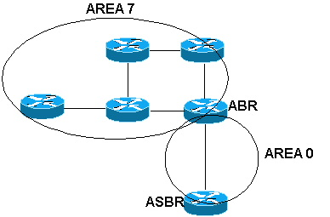

Slide 134
